Slide 1
Data source - Dataset

Slide 2
Data source - Dataset
120-years-of-olympic-history-athletes-and-results - kaggle
athlete_events.csv
noc_regions.csv
Economy study published dataset- Maddison, Angus (2006). The World Economy
GDP of Soviet Union pre 1991
Country, Regional and World GDPuntry, Regional and World -kaggle
GDP of Russia post 1991

Slide 3
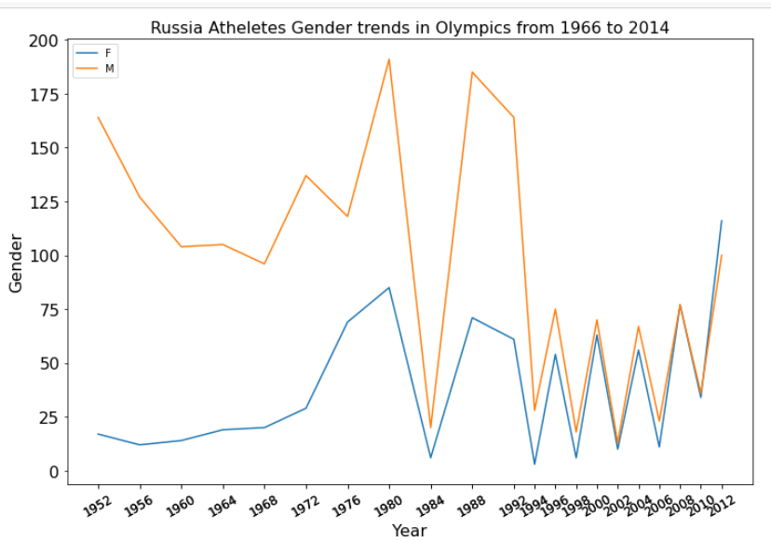
Athletes Gender Analysis
1950s-1960s Male athletes had an overwhelming percentage of the participates population, while few female athletes completed on behalf of Soviet Union.
The ratio of female participation has been improving , in recent years female athletes' percentage has been increasing even surpassing the male athletes' ratio.

Slide 4
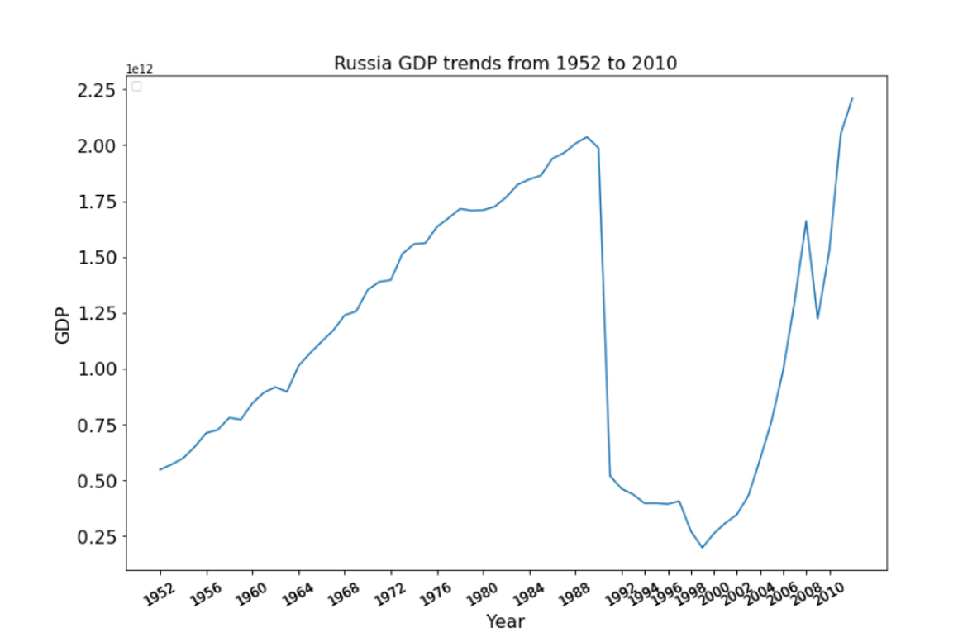
Soviet Union/Russia National Nominal GDP Analysis
GDP witnessed decades of increase before dissolution.
Following the collapse of the Soviet Union, the GDP took a dramatic drop.
GDP number had been collapsing through 1990s but Russia bounced back from the August 1998 financial crash with a surprising speed.

Slide 5
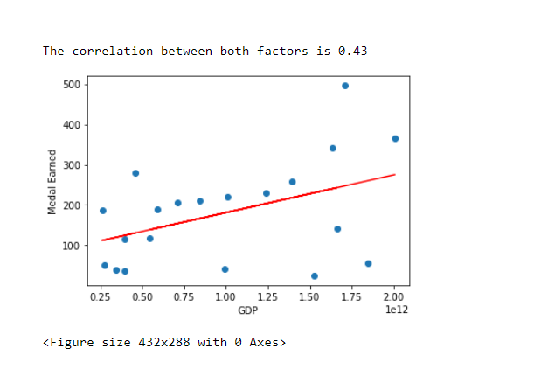
Nominal GDP/ Medal earned correlation Analysis
The plot examines the total medal counts vary with Soviet Union/ Russia country nominal GDP.
The correlation is 0.43
Relationship is not too far from linear. The graph suggests the GDP and medal counts over the years are positively correlated.

